Slide 1

Application layer: overview
P2P applications
video streaming and content distribution networks
socket programming with UDP and TCP
Principles of network applications
Web and HTTP
E-mail, SMTP, IMAP
The Domain Name System DNS

Slide 2
Web and HTTP
First, a quick review…
web page consists of objects, each of which can be stored on different Web servers
object can be HTML file, JPEG image, Java applet, audio file,…
web page consists of base HTML-file which includes several referenced objects, each addressable by a URL, e.g.,
www.someschool.edu/someDept/pic.gif
host name
path name

Slide 3


HTTP overview
HTTP: hypertext transfer protocol
Web’s application-layer protocol
client/server model:
  client: browser that requests, receives, (using HTTP protocol) and “displays” Web objects
  server: Web server sends (using HTTP protocol) objects in response to requests
HTTP request
PC running
Firefox browser
HTTP response
HTTP request
server running
Apache Web
server
HTTP response
iPhone running
Safari browser

Slide 4
HTTP overview (continued)
HTTP uses TCP:
client initiates TCP connection (creates socket) to server, port 80
server accepts TCP connection from client
HTTP messages (application-layer protocol messages) exchanged between browser (HTTP client) and Web server (HTTP server)
TCP connection closed
HTTP is “stateless”
server maintains no information about past client requests
aside
protocols that maintain “state” are complex!
past history (state) must be maintained
if server/client crashes, their views of “state” may be inconsistent, must be reconciled

Slide 5
HTTP request message
two types of HTTP messages: request, response
HTTP request message:
  ASCII (human-readable format)
carriage return character
request line (GET, POST,
HEAD commands)
line-feed character
GET /index.html HTTP/1.1\r\n
Host: www-net.cs.umass.edu\r\n
User-Agent: Mozilla/5.0 (Macintosh; Intel Mac OS X 10.15; rv:80.0) Gecko/20100101 Firefox/80.0 \r\n
Accept: text/html,application/xhtml+xml\r\n
Accept-Language: en-us,en;q=0.5\r\n
Accept-Encoding: gzip,deflate\r\n
Connection: keep-alive\r\n
\r\n
header
lines
carriage return, line feed at start of line indicates end of header lines
* Check out the online interactive exercises for more examples: http://gaia.cs.umass.edu/kurose_ross/interactive/

Slide 6
HTTP request message: general format
method
sp
URL
sp
version
cr
lf
request
line
header field name
value
cr
lf
~
~
header
lines
~
~
header field name
value
cr
lf
cr
lf
~
entity body
~
body
~
~

Slide 7
Other HTTP request messages
POST method:
web page often includes form input
user input sent from client to server in entity body of HTTP POST request message
HEAD method:
requests headers (only) that would be returned if specified URL were requested with an HTTP GET method.
PUT method:
uploads new file (object) to server
completely replaces file that exists at specified URL with content in entity body of POST HTTP request message
GET method (for sending data to server):
include user data in URL field of HTTP GET request message (following a ‘?’):
www.somesite.com/animalsearch?monkeys&banana

Slide 8
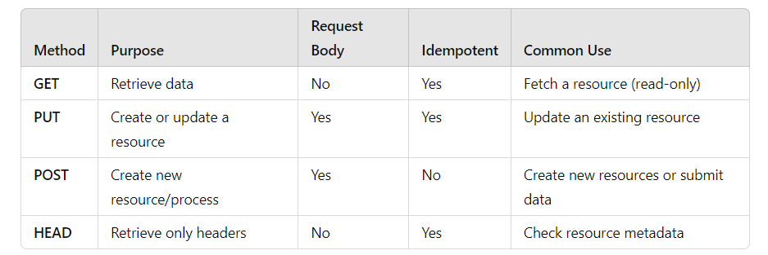
Key Differences

Slide 9
HTTP response message
status line (protocol
status code status phrase)
HTTP/1.1 200 OK
Date: Tue, 08 Sep 2020 00:53:20 GMT
Server: Apache/2.4.6 (CentOS) OpenSSL/1.0.2k-fips PHP/7.4.9 mod_perl/2.0.11 Perl/v5.16.3
Last-Modified: Tue, 01 Mar 2016 18:57:50 GMT
ETag: "a5b-52d015789ee9e"
Accept-Ranges: bytes
Content-Length: 2651
Content-Type: text/html; charset=UTF-8
\r\n
data data data data data ...
header
lines
data, e.g., requested
HTML file
* Check out the online interactive exercises for more examples: http://gaia.cs.umass.edu/kurose_ross/interactive/

Slide 10
HTTP response status codes
status code appears in 1st line in server-to-client response message.
some sample codes:
200 OK
  request succeeded, requested object later in this message
301 Moved Permanently
  requested object moved, new location specified later in this message (in Location: field)
400 Bad Request
  request msg not understood by server
404 Not Found
  requested document not found on this server
505 HTTP Version Not Supported

Slide 11
Trying out HTTP (client side) for yourself
1. netcat to your favorite Web server:
% nc -c -v gaia.cs.umass.edu 80 (for Mac)
>ncat –C gaia.cs.umass.edu 80 (for Windows)
opens TCP connection to port 80 (default HTTP server port) at gaia.cs.umass.edu.
anything typed in will be sent to port 80 at gaia.cs.umass.edu
2. type in a GET HTTP request:
GET /kurose_ross/interactive/index.php HTTP/1.1
Host: gaia.cs.umass.edu
by typing this in (hit carriage return twice), you send this minimal (but complete) GET request to HTTP server
3. look at response message sent by HTTP server!
(or use Wireshark to look at captured HTTP request/response)
Notes:
nc -v gaia.cs.umass.edu 80
In Linux

Slide 12
Application layer: overview
P2P applications
video streaming and content distribution networks
socket programming with UDP and TCP
Principles of network applications
Web and HTTP
E-mail, SMTP, IMAP
The Domain Name System DNS

Slide 13
E-mail
user
agent
Three major components:
user agents
mail servers
simple mail transfer protocol: SMTP
User Agent
a.k.a. “mail reader”
composing, editing, reading mail messages
e.g., Outlook, iPhone mail client
outgoing, incoming messages stored on server
mail
server
user
agent
SMTP
mail
server
user
agent
SMTP
SMTP
user
agent
mail
server
user
agent
user
agent
outgoing
message queue
user mailbox

Slide 14
E-mail: mail servers
user
agent
mail servers:
mailbox contains incoming messages for user
message queue of outgoing (to be sent) mail messages
SMTP protocol between mail servers to send email messages
client: sending mail server
“server”: receiving mail server
mail
server
user
agent
SMTP
mail
server
user
agent
SMTP
SMTP
user
agent
mail
server
user
agent
user
agent
outgoing
message queue
user mailbox

Slide 15
SMTP RFC (5321)
“client”
SMTP server
“server”
SMTP server
uses TCP to reliably transfer email message from client (mail server initiating connection) to server, port 25
  direct transfer: sending server (acting like client) to receiving server
three phases of transfer
  SMTP handshaking (greeting)
  SMTP transfer of messages
  SMTP closure
command/response interaction (like HTTP)
  commands: ASCII text
  response: status code and phrase
initiate TCP
connection
RTT
TCP connection
initiated
Service ready
220
SMTP handshaking
HELO
250 Hello
SMTP transfers
time

Slide 16


Scenario: Alice sends e-mail to Bob
1) Alice uses UA to compose e-mail message “to” bob@someschool.edu
4) SMTP client sends Alice’s message over the TCP connection
2) Alice’s UA sends message to her mail server using SMTP; message placed in message queue
5) Bob’s mail server places the message in Bob’s mailbox
3) client side of SMTP at mail server opens TCP connection with Bob’s mail server
6) Bob invokes his user agent to read message
user
agent
mail
server
user
agent
1
mail
server
2
3
6
4
Alice’s mail server
5
Bob’s mail server

Slide 17
Sample SMTP interaction
220 <domain> Service ready
S: 220 hamburger.edu
C: HELO crepes.fr
S: 250 Hello crepes.fr, pleased to meet you
C: MAIL FROM: <alice@crepes.fr>
S: 250 alice@crepes.fr... Sender ok
C: RCPT TO: <bob@hamburger.edu>
S: 250 bob@hamburger.edu ... Recipient ok
C: DATA
S: 354 Enter mail, end with "." on a line by itself
C: Do you like ketchup?
C: How about pickles?
C: .
S: 250 Message accepted for delivery
C: QUIT
S: 221 hamburger.edu closing connection
Notes:
250 Requested mail action okay, completed
The SMTP HELO clause is the stage of the SMTP protocol where a SMTP server introduce them selves to each other

Slide 18
SMTP: observations
comparison with HTTP:
HTTP: client pull
SMTP: client push
both have ASCII command/response interaction, status codes
HTTP: each object encapsulated in its own response message
SMTP: multiple objects sent in multipart message
SMTP uses persistent connections
SMTP requires message (header & body) to be in 7-bit ASCII
SMTP server uses CRLF.CRLF to determine end of message

Slide 19
Mail message format
SMTP: protocol for exchanging e-mail messages, defined in RFC 5321 (like RFC 7231 defines HTTP)
RFC 2822 defines syntax for e-mail message itself (like HTML defines syntax for web documents)
header lines, e.g.,
  To:
  From:
  Subject:
  these lines, within the body of the email message area different from SMTP MAIL FROM:, RCPT TO: commands!
Body: the “message” , ASCII characters only
header
blank
line
body

Slide 20
Retrieving email: mail access protocols
user
agent
e-mail access
protocol
user
agent
SMTP
SMTP
(e.g., IMAP, HTTP)
sender’s e-mail
server
receiver’s e-mail
server
SMTP: delivery/storage of e-mail messages to receiver’s server
mail access protocol: retrieval from server
  IMAP: Internet Mail Access Protocol [RFC 3501]: messages stored on server, IMAP provides retrieval, deletion, folders of stored messages on server
HTTP: gmail, Hotmail, Yahoo!Mail, etc. provides web-based interface on top of STMP (to send), IMAP (or POP) to retrieve e-mail messages

Slide 21
Application Layer: Overview
P2P applications
video streaming and content distribution networks
socket programming with UDP and TCP
Principles of network applications
Web and HTTP
E-mail, SMTP, IMAP
The Domain Name System DNS

Slide 22
DNS: Domain Name System
people: many identifiers:
  SSN, name, passport #
Internet hosts, routers:
  IP address (32 bit) - used for addressing datagrams
  “name”, e.g., cs.umass.edu - used by humans
Q: how to map between IP address and name, and vice versa ?
Domain Name System (DNS):
distributed database implemented in hierarchy of many name servers
application-layer protocol: hosts, DNS servers communicate to resolve names (address/name translation)
  note: core Internet function, implemented as application-layer protocol
  complexity at network’s “edge”

Slide 23
DNS: services, structure
DNS services:
hostname-to-IP-address translation
host aliasing
  canonical, alias names
mail server aliasing
load distribution
  replicated Web servers: many IP addresses correspond to one name
Q: Why not centralize DNS?
single point of failure
traffic volume
distant centralized database
maintenance
A: doesn‘t scale!
Comcast DNS servers alone: 600B DNS queries/day
Akamai DNS servers alone: 2.2T DNS queries/day

Slide 24
Host aliasing
Host aliasing in DNS (Domain Name System) is typically achieved using CNAME (Canonical Name) records.
This allows one domain name to be an alias for another, meaning that one domain points to the canonical (true) name or another domain, rather than an IP address directly.

Slide 25
How Host Aliasing Works
CNAME Record: A CNAME record is used to map an alias (or alternative name) to a true or canonical domain name.
  Example: Suppose you have two domain names, example.com (canonical name) and www.example.com (alias). The CNAME record for www.example.com could point to example.com, meaning www.example.com is an alias for example.com.

Slide 26
Benefits of Host Aliasing
Flexibility: If the canonical domain's IP changes, you only need to update the DNS record for the canonical domain. All aliases (CNAMEs) will automatically resolve to the new IP.
Ease of Management: It's easier to manage multiple domain names or subdomains pointing to the same service (like a website or application) by using a single canonical name.
Load Distribution: CNAMEs can be used with load balancers or content delivery networks (CDNs) to distribute traffic across multiple servers.

Slide 27

Example
Let’s say you have:
  www.example.com (the alias)
  server1.example.com (the canonical name)
If you set a CNAME record like this:
When someone accesses www.example.com, DNS will resolve it to server1.example.com, and then it resolves server1.example.com to its actual IP address (e.g., 192.0.2.1

Slide 28

Thinking about the DNS
humongous distributed database:
~ billion records, each simple
handles many trillions of queries/day:
many more reads than writes
performance matters: almost every Internet transaction interacts with DNS - msecs count!
organizationally, physically decentralized:
millions of different organizations responsible for their records
“bulletproof”: reliability, security
Notes:
Humongous: khổng lồ
Trillions: hàng nghìn tỉ

Slide 29
DNS: a distributed, hierarchical database
Root DNS Servers
Root
…
…
.com DNS servers
.org DNS servers
.edu DNS servers
Top Level Domain
…
…
…
…
yahoo.com
DNS servers
amazon.com
DNS servers
pbs.org
DNS servers
nyu.edu
DNS servers
umass.edu
DNS servers
Authoritative
Client wants IP address for www.amazon.com; 1st approximation:
client queries root server to find .com DNS server
client queries .com DNS server to get amazon.com DNS server
client queries amazon.com DNS server to get IP address for www.amazon.com
Notes:
Authoritative: có thẩm quyền

Slide 30
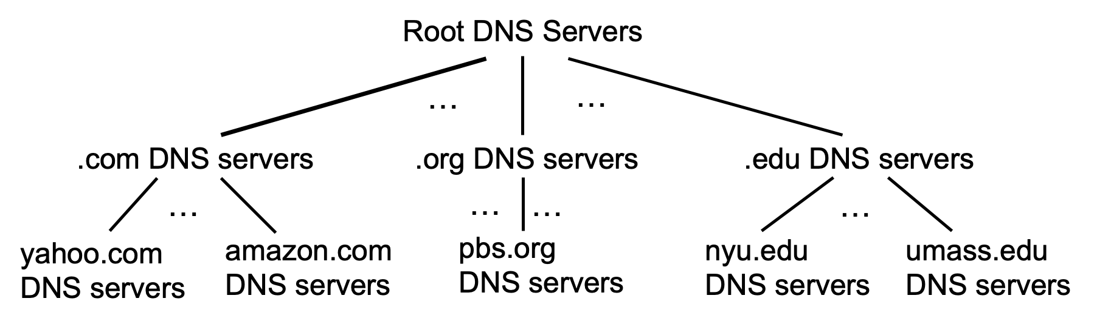
DNS: root name servers
official, contact-of-last-resort by name servers that can not resolve name

Slide 31
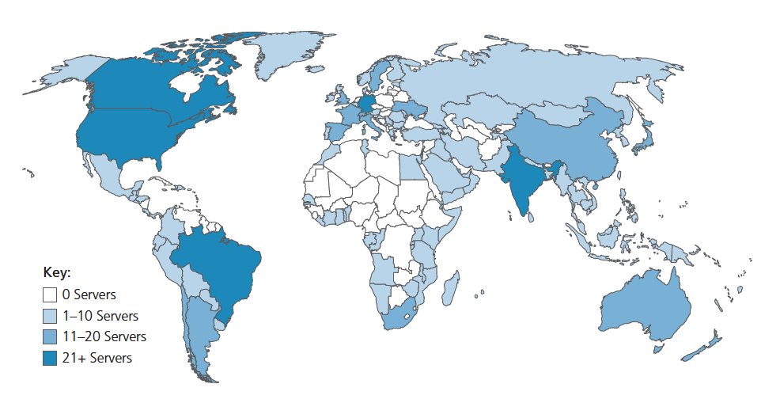
DNS: root name servers
official, contact-of-last-resort by name servers that can not resolve name
incredibly important Internet function
  Internet couldn’t function without it!
  DNSSEC – provides security (authentication, message integrity)
ICANN (Internet Corporation for Assigned Names and Numbers) manages root DNS domain
13 logical root name “servers” worldwide each “server” replicated many times (~200 servers in US)

Slide 32
Top-Level Domain, and authoritative servers
Top-Level Domain (TLD) servers:
  responsible for .com, .org, .net, .edu, .aero, .jobs, .museums, and all top-level country domains, e.g.: .cn, .uk, .fr, .ca, .jp
  Network Solutions: authoritative registry for .com, .net TLD
  Educause: .edu TLD
authoritative DNS servers:
  organization’s own DNS server(s), providing authoritative hostname to IP mappings for organization’s named hosts
  can be maintained by organization or service provider

Slide 33
Local DNS name servers
when host makes DNS query, it is sent to its local DNS server
  Local DNS server returns reply, answering:
    from its local cache of recent name-to-address translation pairs (possibly out of date!)
    forwarding request into DNS hierarchy for resolution
  each ISP has local DNS name server; to find yours:
    MacOS: % scutil --dns
    Windows: >ipconfig /all
local DNS server doesn’t strictly belong to hierarchy

Slide 34
DNS name resolution: iterated query
root DNS server
Example: host at engineering.nyu.edu wants IP address for gaia.cs.umass.edu
2
3
TLD DNS server
Iterated query:
contacted server replies with name of server to contact
“I don’t know this name, but ask this server”
1
4
8
5
requesting host at
engineering.nyu.edu
local DNS server
dns.nyu.edu
gaia.cs.umass.edu
7
6
authoritative DNS server
dns.cs.umass.edu
Notes:
Iterated: lặp lại

Slide 35
DNS name resolution: recursive query
root DNS server
Example: host at engineering.nyu.edu wants IP address for gaia.cs.umass.edu
2
3
7
6
Recursive query:
puts burden of name resolution on contacted name server
heavy load at upper levels of hierarchy?
1
TLD DNS server
8
requesting host at
engineering.nyu.edu
local DNS server
dns.nyu.edu
5
4
gaia.cs.umass.edu
authoritative DNS server
dns.cs.umass.edu

Slide 36
Caching DNS Information
once (any) name server learns mapping, it caches mapping, and immediately returns a cached mapping in response to a query
  caching improves response time
  cache entries timeout (disappear) after some time (TTL)
  TLD servers typically cached in local name servers
cached entries may be out-of-date
  if named host changes IP address, may not be known Internet-wide until all TTLs expire!
  best-effort name-to-address translation!

Slide 37
DNS records
DNS: distributed database storing resource records (RR)
RR format: (name, value, type, ttl)
type=A
  name is hostname
  value is IP address
type=CNAME
  name is alias name for some “canonical” (the real) name
  www.ibm.com is really servereast.backup2.ibm.com
  value is canonical name
type=NS
  name is domain (e.g., foo.com)
  value is hostname of authoritative name server for this domain
type=MX
  value is name of SMTP mail server associated with name

Slide 38
DNS protocol messages
DNS query and reply messages, both have same format:
2 bytes
2 bytes
message header:
identification: 16 bit # for query, reply to query uses same #
flags:
  query or reply
  recursion desired
  recursion available
  reply is authoritative
identification
flags
# questions
# answer RRs
# authority RRs
# additional RRs
questions (variable # of questions)
answers (variable # of RRs)
authority (variable # of RRs)
additional info (variable # of RRs)

Slide 39
DNS protocol messages
DNS query and reply messages, both have same format:
2 bytes
2 bytes
identification
flags
# questions
# answer RRs
# authority RRs
# additional RRs
name, type fields for a query
questions (variable # of questions)
RRs in response to query
answers (variable # of RRs)
records for authoritative servers
authority (variable # of RRs)
additional “ helpful” info that may be used
additional info (variable # of RRs)

Slide 40
Getting your info into the DNS
example: new startup “Network Utopia”
register name networkuptopia.com at DNS registrar (e.g., Network Solutions)
  provide names, IP addresses of authoritative name server (primary and secondary)
  registrar inserts NS, A RRs into .com TLD server:
  (networkutopia.com, dns1.networkutopia.com, NS)
  (dns1.networkutopia.com, 212.212.212.1, A)
create authoritative server locally with IP address 212.212.212.1
  type A record for www.networkuptopia.com
  type MX record for networkutopia.com

